Slide 1
Benchmarking in US Onshore: Foster competition and continuous improvement
Allison Sandlin, Equinor, USA

Slide 2
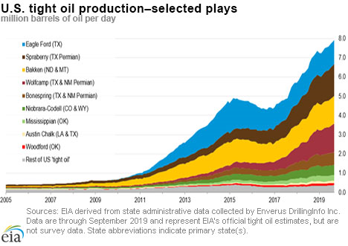
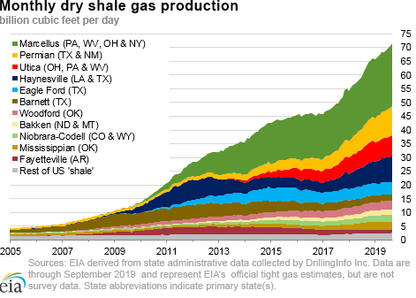
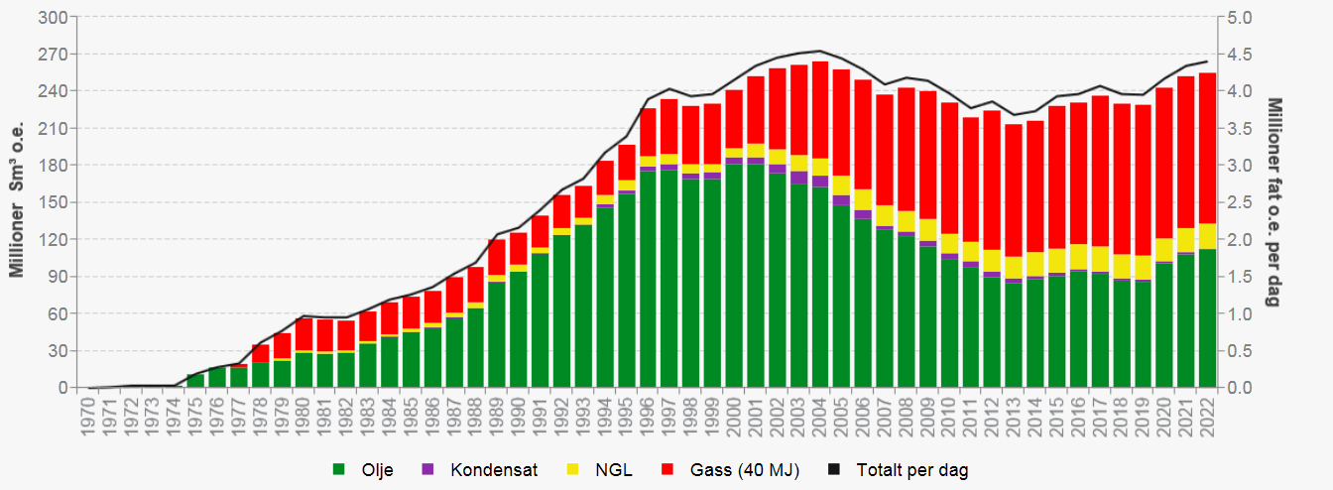
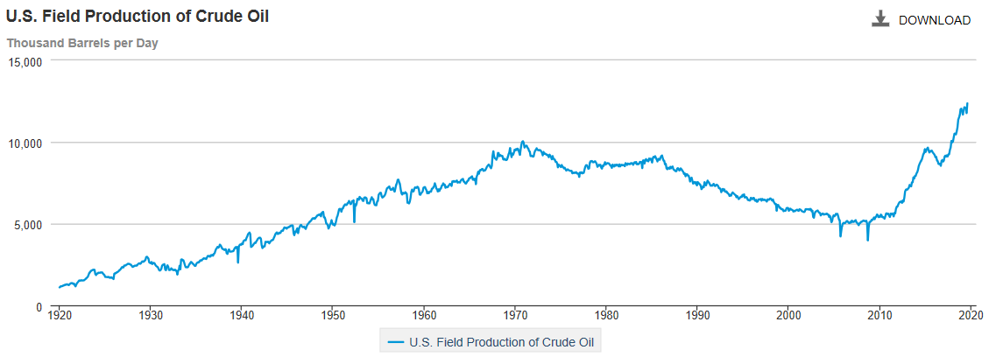
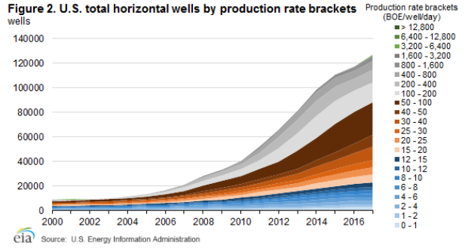
Norway oil and gas production
Ca 12 bcf/d
3 Mbbl/d

